Slide 1
The probability scale
Probability: theoretical probabilities

Slide 2
How our teaching resources are designed for the classroom

Slide 3
I can assign a numerical value to an outcome to give the probability that the outcome will occur.

Slide 4
An outcome is impossible if there is no possibility that it can happen.
An outcome is certain if it is guaranteed to happen.
An outcome has even chance if its likelihood of happening is the same as its likelihood of not happening.
An experiment is a repetition of a trial multiple times in order to observe how often each outcome occurs.

Slide 5
The probability that an event will occur is the proportion of times the event is expected to happen in a suitably large experiment.

Slide 6

The probability scale
Expressing probabilities: percentages and decimals
Expressing probabilities as fractions

Slide 7
Expressing probabilities: percentages and decimals
Probability is a measure of the likelihood of an outcome happening.
Words such as ‘likely’ and ‘unlikely’ are words that describe the likelihood an event will occur but they are relatively vague.
Probabilities describe the likelihoods of an event in a more precise way by using a numerical value to indicate its likelihood.
The probability that an event will occur is the proportion of times the event is expected to happen in a suitably large experiment.

Slide 8
Expressing probabilities: percentages and decimals
An event that is certain has 100% probability of happening.
E.g. 100% of the trials conducted with this spinner would be ‘win’.
win
100%
impossible
even chance
certain
unlikely
likely

Slide 9
Expressing probabilities: percentages and decimals
An event that is impossible has 0% probability of happening.
E.g. 0 of the trials conducted with this spinner would be ‘win’.
lose
win
0%
100%
impossible
even chance
certain
unlikely
likely

Slide 10
Expressing probabilities: percentages and decimals
An event that has an even chance has 50% probability of happening.
E.g. If we conducted a large number of trials with this spinner then we would expect that approximately 50% of the outcomes would be ‘win’.
win
lose
lose
win
0%
50%
100%
impossible
even chance
certain
unlikely
likely

Slide 11
Expressing probabilities: percentages and decimals
Probabilities greater than 50% have more than an even chance of happening.
E.g. If we conducted a large number of trials with this spinner, then we would expect it to land on ‘win’ more often than it lands on ‘lose’.
win
win
lose
lose
lose
win
0%
50%
60%
70%
80%
90%
100%
impossible
even chance
certain
likely

Slide 12
Expressing probabilities: percentages and decimals
Probabilities less than 50% have less than an even chance of happening.
E.g. If we conducted a large number of trials with this spinner, then we would expect it to land on ‘win’ less often than it lands on ‘lose’.
lose
win
win
lose
lose
win
lose
win
0%
10%
20%
30%
40%
50%
60%
70%
80%
90%
100%
impossible
even chance
certain
unlikely
likely

Slide 13
Expressing probabilities: percentages and decimals
Probabilities can also be expressed using the equivalent decimals.
A probability of 0 means that an event is impossible.
A probability of 1 means that an event is certain.
The size of the number indicates how likely it is for an event to occur.
lose
win
win
lose
lose
win
lose
win
0
0.1
0.2
0.3
0.4
0.5
0.6
0.7
0.8
0.9
1
impossible
even chance
certain
unlikely
likely

Slide 14

Expressing probabilities: percentages and decimals
Which spinner has a 48% probability of landing on ‘win’?
lose
win
lose
win
lose
win

Slide 15


Expressing probabilities: percentages and decimals
A spinner has four outcomes: ξ = {A, B, C, D }
The outcomes are not equally likely to happen.
The probability of the spinner landing on A is 25%
The probability of the spinner landing on B is 18%
The probability of the spinner landing on C is 34%
The probability of the spinner landing on D is 23%
Sam
This seems like a long way of stating these probabilities. I wonder if there is any notation that could be used to shorten this information?

Slide 16
Expressing probabilities: percentages and decimals
Statements about probability can be expressed more efficiently by using the notation ‘P(outcome) =’.
E.g. The probability of the spinner landing on A is 25%.
P(A) = 25%
‘P’ for ‘probability’
outcome inside the brackets
numerical value of probability

Slide 17
Expressing probabilities: percentages and decimals
A spinner has four outcomes: ξ = {A, B, C, D }
The probabilities for each outcome are below.
D
A
P(A) = 25%
P(B) = 18%
C
B
P(C) = 34%
P(D) = 23%
Which outcome would you expect to occur the most often?
C
B
Which outcome would you expect to occur the least often?
If there were 2000 trials, approximately how many times could the spinner be expected to land on A?
25% of 2000 = 500

Slide 18

Expressing probabilities: percentages and decimals
A video game based on chance has a 25% probability of a ‘win’.
Which number below is the most reasonable estimate for how many wins could be expected in 1000 games?
a
50
b
250
c
500
d
1000

Slide 19
Expressing probabilities: percentages and decimals
1) Write the probabilities below in the correct order on the probability scale.
0%, 100%, 20%, 75%, 50%, 45%, 55%
impossible
unlikely
even chance
likely
certain
2) Write the probabilities below in the correct order on the probability scale.
1, 0, 0.5, 0.1, 0.35, 0.95, 0.6
impossible
unlikely
even chance
likely
certain

Slide 20
Expressing probabilities: percentages and decimals
3) In each question you are given a spinner and a choice of four probabilities. In each question, tick the probability that the spinner would land on ‘win’.
a)
0.5%
b)
0
c)
0.1
1%
0.5
lose
0.45
win
lose
2%
win
1
0.5
win
50%
100
0.9
d)
40%
e)
50%
f)
0.1
win
lose
50%
win
52%
win
lose
0.45
52%
lose
75%
0.5
95%
98%
0.6

Slide 21
Expressing probabilities: percentages and decimals
1) Write the probabilities below in the correct order on the probability scale.
0%, 100%, 20%, 75%, 50%, 45%, 55%
0%
20%
45%
50%
55%
75%
100%
impossible
unlikely
even chance
likely
certain
2) Write the probabilities below in the correct order on the probability scale.
1, 0, 0.5, 0.1, 0.35, 0.95, 0.6
0
0.1
0.35
0.5
0.6
0.95
1
impossible
unlikely
even chance
likely
certain

Slide 22
Expressing probabilities: percentages and decimals
3) In each question you are given a spinner and a choice of four probabilities. In each question, tick the probability that the spinner would land on ‘win’.
a)
0.5%
b)
0
c)
0.1
1%
0.5
lose
0.45
win
lose
2%
win
1
0.5
win
50%
100
0.9
d)
40%
e)
50%
f)
0.1
win
lose
50%
win
52%
win
lose
0.45
52%
lose
75%
0.5
95%
98%
0.6

Slide 23
The probability scale
Expressing probabilities: percentages and decimals
Expressing probabilities as fractions

Slide 24
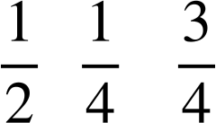
Expressing probabilities as fractions
Probabilities can also be expressed using the equivalent fractions.
A probability of 0 means that an event is impossible.
A probability of 1 whole means that an event is certain.
A probability of a half means that an event has an even chance.
Probabilities less than a half indicate an event is unlikely to happen.
Probabilities greater than a half indicate an event is likely to happen.
lose
win
lose
win
lose
win
lose
win
0
1
impossible
unlikely
even chance
likely
certain

Slide 25
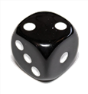
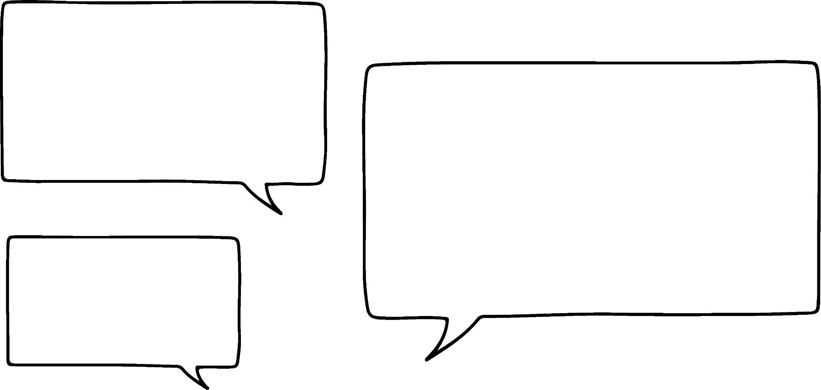
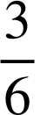
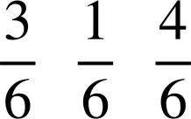



Expressing probabilities as fractions
Andeep, Izzy and Laura are playing a board game that involves rolling a regular six-sided dice. They have each noted which numbers would help them on their next dice roll.
The probability that I’ll roll a number I want on my next turn is .
The probability that I’ll roll a number I want on my next turn is .
The probability that I’ll roll a number I want on my next turn is .
Andeep
Izzy
Laura
Who is the most likely to roll a number they want next turn?
Laura

Slide 26
Expressing probabilities as fractions
Andeep, Izzy and Laura are playing a board game that involves rolling a regular six-sided dice. They have each noted which numbers would help them on their next dice roll.
The probability that I’ll roll a number I want on my next turn is .
The probability that I’ll roll a number I want on my next turn is .
The probability that I’ll roll a number I want on my next turn is .
Andeep
Izzy
Laura
Who has an even chance of rolling a number they want?
Andeep

Slide 27
Expressing probabilities as fractions
Andeep, Izzy and Laura are playing a board game that involves rolling a regular six-sided dice. They have each noted which numbers would help them on their next dice roll.
The probability that I’ll roll a number I want on my next turn is .
The probability that I’ll roll a number I want on my next turn is .
The probability that I’ll roll a number I want on my next turn is .
Andeep
Izzy
Laura
Andeep
Izzy
is three times as likely as to get a number he wants.

Slide 28
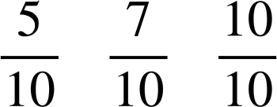
Expressing probabilities as fractions
The probabilities for three unrelated events are listed below.
P(A) =
P(B) =
P(C) =
Which event is the least likely to happen?
A

Slide 29
Expressing probabilities as fractions
The probabilities for three unrelated events are listed below.
P(A) =
P(B) =
P(C) =
Which event is certain to happen?
C

Slide 30



Expressing probabilities as fractions
Alex is going to spin the spinner 40 times and record his results.
How many times should he expect the spinner to land on ‘win’?
I expect the spinner to land on ‘win’ approximately times.
10
win
lose
lose
lose
That’s because I would expect it to land on each sector an equal number of times.
But that might not necessarily happen.

Slide 31

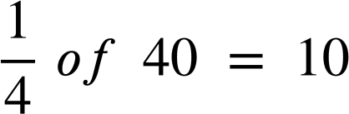
Expressing probabilities as fractions
An outcome with a probability of could be expected to happen in
approximately of the total trials performed.
E.g. In an experiment with 40 trials, we might expect the outcome to happen approximately 10 times.
of
The more trials an experiment contains, the more likely it is that the proportion of outcomes would be similar to what was expected.

Slide 32
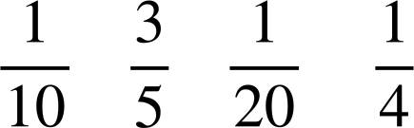
Expressing probabilities as fractions
A spinner has four numbers on. The probabilities of the spinner landing on each number are below.
P(1) =
P(2) =
P(3) =
P(4) =
During a game, the spinner is spun a total of 100 times.
Which number could be expected occur the most frequently?
2

Slide 33
Expressing probabilities as fractions
A spinner has four numbers on. The probabilities of the spinner landing on each number are below.
P(1) =
P(2) =
P(3) =
P(4) =
During a game, the spinner is spun a total of 100 times.
Approximately, how many times could the spinner be expected to land on the number 4?
25

Slide 34
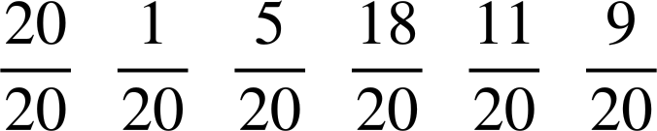
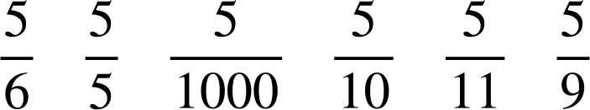
Expressing probabilities as fractions
1) Write the probabilities below in the correct order on the probability scale.
impossible
unlikely
even chance
likely
certain
2) Write the probabilities below in the correct order on the probability scale.
impossible
unlikely
even chance
likely
certain

Slide 35


Expressing probabilities as fractions
3) Fill in the blanks in the table.
event | probability as a fraction | probability as a decimal | probability as a percentage | description of likelihood | expected frequency in 600 trials
example |  | 0.5 | 50% | even chance | 300
A |  | 0.25 |  | unlikely
B |  |  | 75%
C
D |  |  |  |  | 0

Slide 36

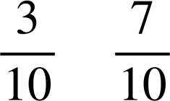

Expressing probabilities as fractions
4) A dropped cone could land in one of two ways: ‘base down’ or ‘curve down’.
A large experiment concluded the following probabilities:
P(base down) = P(curve down) =
a) The cone is about to be dropped again. Which outcome is most likely to happen?
b) In an experiment with 100 trials, approximately how many times could you expect the cone to land curve down?
c) Use the link to access a simulation of this experiment: Cone simulation🖇 The box that says ‘count’ shows the number of trials completed. Press the ‘run’ button to begin the simulation and let it run for 100 trials.
Are the results the same as what you predicted in part (b)?

Slide 37
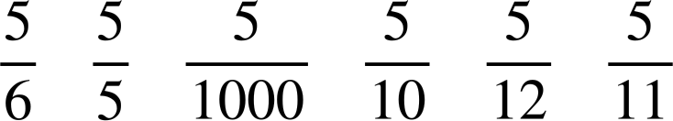
Expressing probabilities as fractions
1) Write the probabilities below in the correct order on the probability scale.
impossible
unlikely
even chance
likely
certain
2) Write the probabilities below in the correct order on the probability scale.
impossible
unlikely
even chance
likely
certain

Slide 38
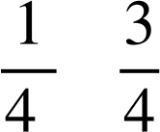
Expressing probabilities as fractions
3) Fill in the blanks in the table.
event | probability as a fraction | probability as a decimal | probability as a percentage | description of likelihood | expected frequency in 600 trials
example |  | 0.5 | 50% | even chance | 300
A |  | 0.25 |  | unlikely
B |  |  | 75%
C
D |  |  |  |  | 0
25%
150
0.75
likely
450
0.4
40%
unlikely
240
0
0
0%
impossible

Slide 39

Expressing probabilities as fractions
4) A dropped cone could land in one of two ways: ‘base down’ or ‘curve down’.
A large experiment concluded the following probabilities:
P(base down) = P(curve down) =
a) The cone is about to be dropped again. Which outcome is most likely to happen?
curve down
b) In an experiment with 100 trials, approximately how many times could you expect the cone to land curve down?
of 100 = 70

Slide 40
Expressing probabilities as fractions
c) Use the link to access a simulation of this experiment: Cone simulation🖇 The box that says ‘count’ shows the number of trials completed. Press the ‘run’ button to begin the simulation and let it run for 100 trials.
Are the results the same as what you predicted in part (b)?
Example answers:
‘The results were similar to my prediction but not the same.’
‘There were 89 results for curve down, which is more than what I expected.’
‘The number of times it landed curve down was much more than the number of times it landed base down, which was what I expected. But the exact number of times it landed on each side differed to what I expected.’
Answers may vary depending on results from the simulation.

Slide 41
The probability scale
Probability is a measure of the likelihood of an outcome happening.
Probabilities take numerical values between 0 and 1.
A probability of 0 means that the outcome is impossible.
A probability of 1 means that an outcome is certain.
The probability that an event will occur is the proportion of times the event is expected to happen in a suitably large experiment.

Slide 42

© Oak National Academy 2024.
Produced in partnership with Mathematics in Education and Industry.
Licensed on the Open Government Licence v3.0, except where otherwise stated. See Oak terms and conditions.

